Slide 1
Saint Mary’s College
The
Accreditation
Journey

Slide 2
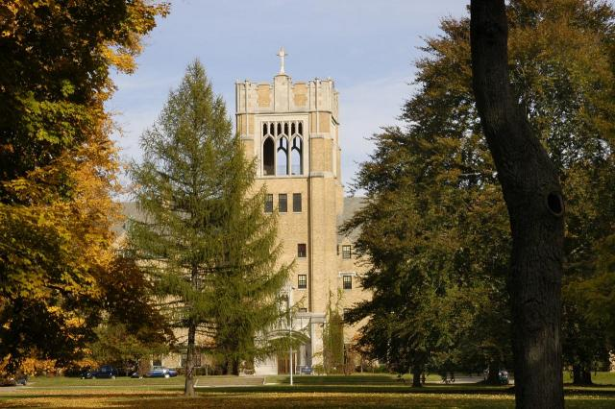
It started in 2005 but
began in earnest when President Mooney
formed the
Accreditation Committee.

Slide 3
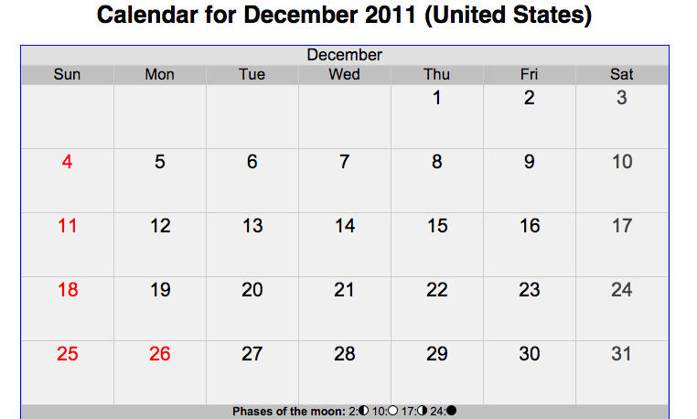
The 1st meeting of the Committee - December 8, 2011
1,350 days ago

Slide 4
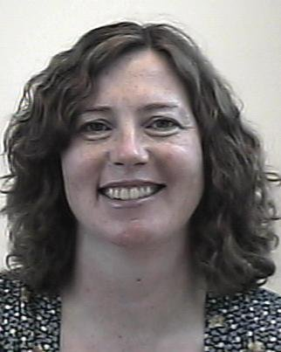
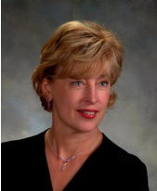
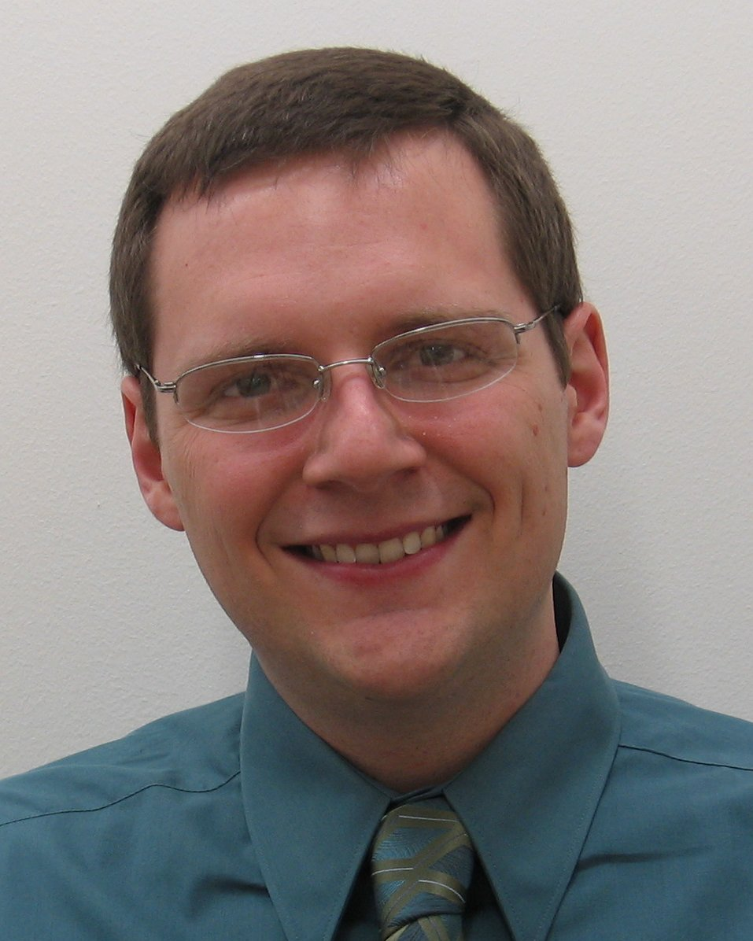
Team Leaders
Julie Storme
Laurel Thomas
Daniel Flowers
Co – team chairs

Slide 5
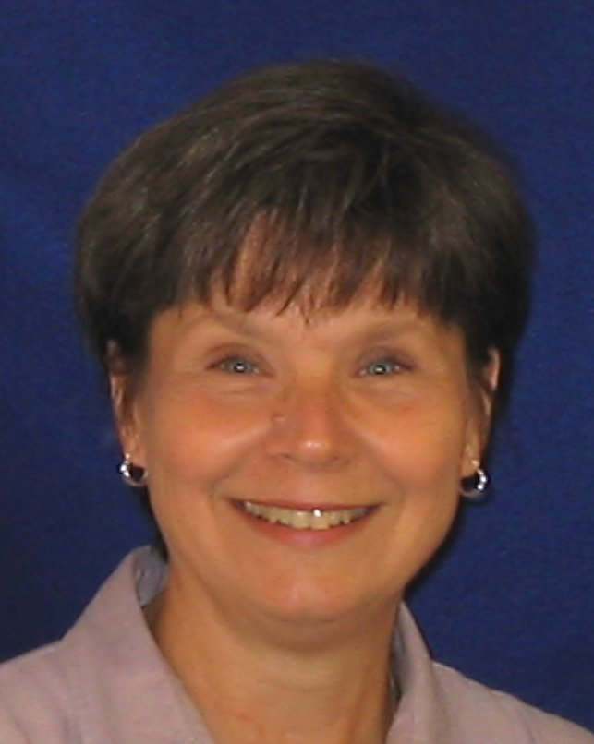
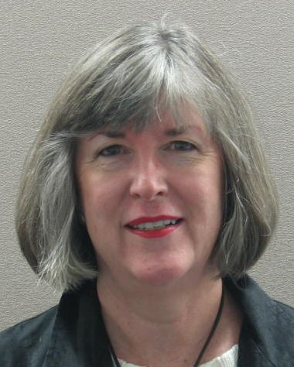
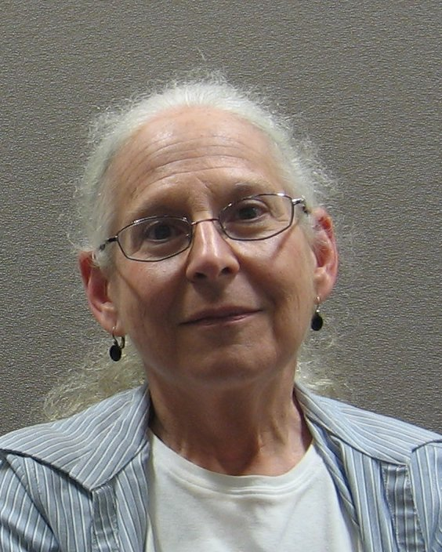
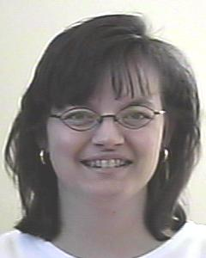
Criterion Coordinators
Judy Fean Mission
Susan Dampeer Ethics & Integrity
Vickie Hess & Colleen Hoover Assessment
Julie Storme & Laurel Thomas Leaders
Daniel Flowers Resources

Slide 6
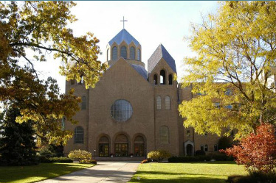
Steering Committee Members
Marc Belanger
Adaline Cashore
Sandi Ginter
Jim Herschel
Jessica Ickes
Joe Incandela
Cassie Majetic
Elaine Mayer-Lee
Todd Norris
Linda Paskiewicz
Janielle Tchakerian
Leslie Wang
Sister Veronique Wiedower

Slide 7
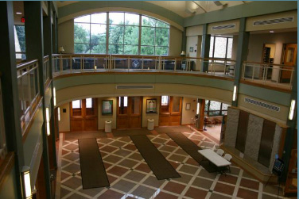
We were chosen for an HLC Project
The Degree Quality Profile
Students and Faculty from the departments of:
Biology
Nursing
Psychology
Modern Languages

Slide 8
9 groups of 4-8 faculty and the Sophia Oversight Committee during spring semester – 2012
80 + faculty at Faculty Development Day –
August 2012
Staff who attended one of two meetings – August 30, 2012

Slide 9
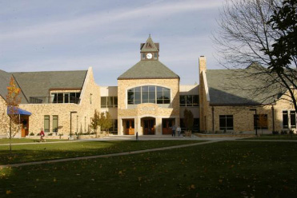
The CRITERION Lunches
2013 – 2014
Many participated
Thank you for your
Valuable Contributions!

Slide 10
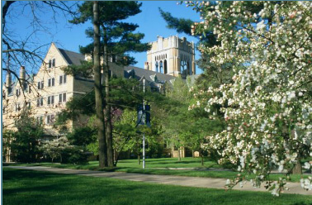
2015
The Spring
Focus Groups

Slide 11
Janielle Tchakerian – Recorder
Elaine Meyer-Lee - Facilitator
Academic Dept by Division Cassie Majetic
Admissions Mona Bowe
Campus Ministry Paulette Kluge
Regina Wilson
College Relations Kara O’Leary
LO3 Coordinator Mana Derakhshani
Mission Council Father John Pearson
Sue Wiegand
OCSE Erika Buhring
V-P for Mission Judy Fean
V-P for Student Affairs Karen Johnson

Slide 12
Addie Cashore – Recorder
Sandi Ginter - Facilitator
Board of Trustees faculty Joanne Snow Stacy Davis
Enrollment Management Mona Bowe
Human Resources Rich Nugent
IRB Colleen Fitzpatrick
President’s Office Susan Dampeer
Student Affairs Karen Johnson

Slide 13
Marc Belanger – Recorder
Joe Incandela - Facilitator
AEL Erika Buhring
Advising Susan Vanek
Chair by Division Chris Dunlap
LO3 Coordinator Mana Derakhshani
WV Coordinator Laura Haigwood
Writing Center Aaron Bremyer
RSVP to blanket invite Indi Dieckgrafe
RSVP to blanket invite Renée Kingcaid
RSVP to blanket invite Addie Cashore

Slide 14
Elaine Meyer-Lee – Recorder
Linda Paskiewicz - Facilitator
Career Crossings Stacie Jeffirs
Chairs by Division Bettina Spencer
Nancy Menk
Nancy Turner
Phil Hicks
Facilities Ben Bowman
Information Technology Michael Boehm
Library Sue Wiegand
RSVP to blanket invite Charles Peltier

Slide 15
Linda Paskiewicz – Recorder
Marc Belanger – Facilitator
Academic Dept by Division Nancy Nekvasil
Mary Ann Kanieski Karen Chambers
Trish Keresztes Assessment Committee Mary Ann Kanieski
Career Crossings Stacie Jeffirs
Curriculum Committee Don Paetkau
Nancy Turner
CWIL Karen Chambers
Institutional Research Brian Matve
Program Review Committee Trish Keresztes
Student representation Margaret Carswell

Slide 16
James Herschel – Recorder
Todd Norris – Facilitator
Academic Dept by Division Joanne Snow
Sandi Ginter
Umberto Taccheri (AA Council)
College Relations Shari Rodriguez
Enrollment Management Mona Bowe
Ex Comm Faculty Assembly Stacy Davis
Facilities Ben Bowman
Financial Aid Kathleen Brown
Information Technology Michael Boehm Kathy Saville
Institutional Research Brian Matve
Library / AA Council Sue Wiegand
Student representation Margaret Carswell

Slide 17
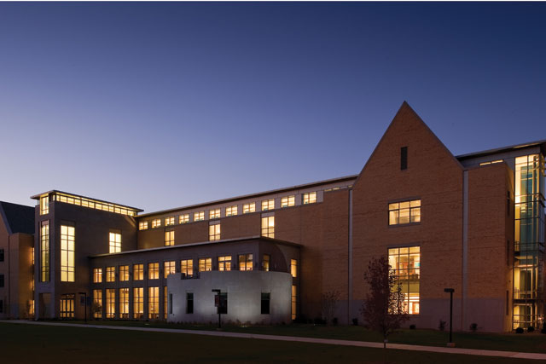
President Mooney’s Contributions
July 2015

Slide 18
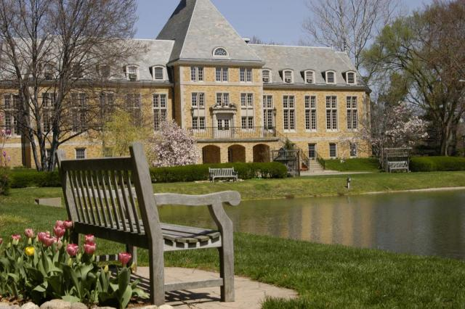
Board of Trustees’ Contributions
August 15
Through
September 15

Slide 19
Final Version for our College September 14, 2015

Slide 20
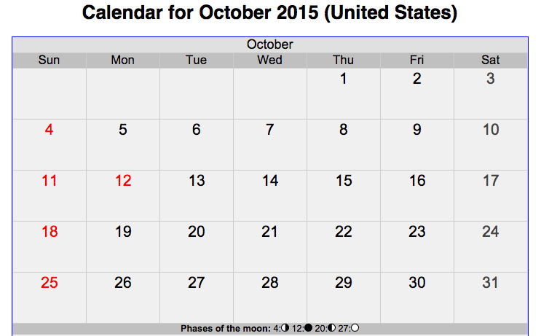
Lock in to HLC

Slide 21
Coming Soon
The HLC Team
November 9 – 10, 2015

Slide 22
HLC Team
Dr. Rita Gulstad VP & Dean – Central Methodist University
Dr. Boyd Creesman
VP for AA – West Virginia Wesleyan College
Dr. Greg R. Gunderson VP & CFO - Webster University
Dr. Felicia Squire Assoc Professor of Language & Literature & Assoc Dean of Faculty & Curriculum – Sterling College
Dr. Marilyn Bugenhagen Associate Academic Affairs Office - Marian University

Slide 23
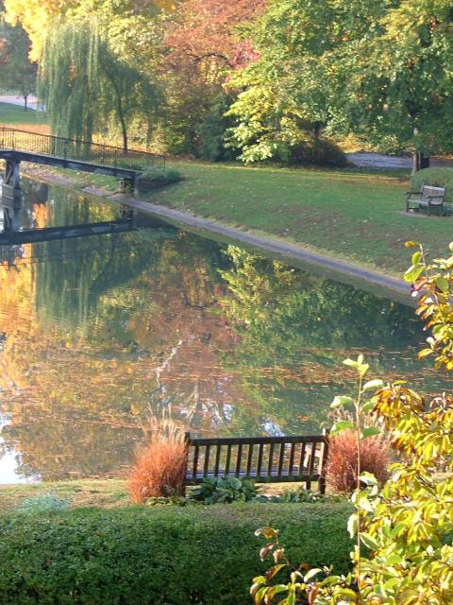
Saint Mary’s College
Thank
You !

